Slide 1
Digital Architecture for Children
In an ideal scenario, what systems would we have to support UNICEF’s high-impact interventions?

Slide 2
3 architectures…
Enterprise architecture What pervasive digital infrastructure do we need so that our system will act like a system?
Functional architecture What things to do we need to do; what workflows do we need to support?
Solution architecture What software products will operationalize these workflows within the context of the enterprise infrastructure?

Slide 3
Enterprise Architecture
Integrated platform supporting:
Health Information Exchange (HIE)
Health Insurance Management Information System (HIMIS)
Civil Registration and Vital Statistics (CRVS)
Supply Chain Management (SCM) including Distribution Requirements Planning (DRP)
Shared ID registries for “cardinal” data assets (e.g. clients, facilities, providers, procedures, commodities, etc.)
Seamless transaction processing across sub-systems; support for whole-system data analytics

Slide 4
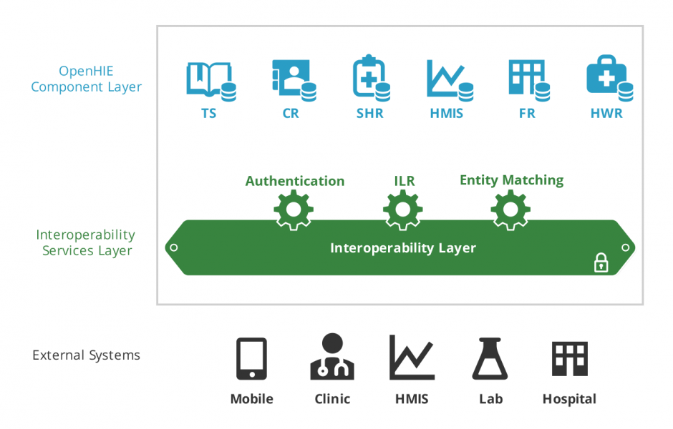
Billing Codes
Beneficiaries
Insurance Transactions
Insurance Analytics
Empaneled Organizations
Empaneled Providers
Social Insurance in support of Universal Health Coverage
(different use of common databases)
Civil Registration and Vital Statistics
Supply Chain Management including DRP
ICP
Engine
eGov Interoperability Layer
$
IZ
Registrar
Insurance
Immunization
SCM
Solutions
Apps
EMR
Solution
EPR
Solution
Solution

Slide 5
Glossary
TS – terminology service
CR – client registry
SHR – shared health repository
HMIS – health management information system
FR – facility registry
HWR – health worker registry
ICP Engine – integrated care pathway (guideline-based workflow) logic engine
ILR – interlinked registry (organizations|facilities|health workers|health services)
SCM – supply chain management
DRP – distribution requirements planning

Slide 6
Functional Architecture
From a couple of dozen “Lego block” transactions, a wide array of functionality can be supported
The transactions are re-usable across public health and curative care workflows and will be operationalized by the shared digital infrastructure
Point-of-service solutions will adhere to “interoperability” patterns that leverage the shared infrastructure’s transactions

Slide 7
Functional Architecture
Create a new client (demographic) record
Update a client record
Query for and retrieve a client record
Query for and retrieve clinical information about a client
Save clinical information about a client
Order medications
Dispense medications
Order lab tests
Receive lab results
Refer a client (escalate care)
Discharge a client
Query for providers, facilities, organizations or services
Execute care guideline logic
Send alerts or reminders to providers or to clients
Aggregate person-centric transactions to generate reportable indicators (HMIS)

Slide 8
Functional Architecture
Share client demographic data with the CRVS system
Establish a client’s health insurance status
Transact the payment of health insurance premiums
Record the provision of insured services
Pay for the provision of insured services
Record (or imply) inventory consumption transactions
Calculate perpetual inventory levels
Record inventory physical counts
Develop inventory replenishment plans (DRP)
Transact supply chain logistics: requisition, order, pick, pack, ship, receive, return, scrap

Slide 9
Particularly useful functionality…
New client demographic records for newborns will automatically be shared with the CRVS system
Insurance status will be managed as an attribute of the client demographic record; authenticating the ID of the client will automatically indicate the available insured services
Posting care delivery transactions to the shared health record (SHR) will automatically create the associated health insurance claim transactions
Recording certain care delivery transactions (e.g. medication dispense) will automatically create inventory consumption transactions
Tick-of-the-clock “events” can generate guideline-based alerts (e.g. vaccination visit reminders, alerts for missed vaccination visits, etc.)

Slide 10
Solution Architecture
Point-of-service digital solutions will be able to transact with the shared digital infrastructure’s “interoperability layer”
The transaction processing pattern will resolve local IDs to enterprise IDs
Information sharing, based on enterprise IDs, will support continuity of guideline-based care over time and across different sites
Paper-based systems will asynchronously update electronic systems via manual data entry and/or the scanning of “engineered paper forms”

Slide 11
Example: Immunization Registry
Solution profile:
Create, update, query/retrieve child demographic records (functional architecture transactions: 1, 2, 3)
Retrieve the child’s present immunization status; based on this status, calculate what vaccines are to be administered (4, 13)
Record weight and, if stock is available, administer vaccines (5, 7)
Based on aggregated vaccine administrations, generate HMIS indicators (15) and deplete inventory (21)
Based on the child’s last visit date and vaccine schedule, send SMS visit reminders to child’s mum, or health worker, or both (3, 12, 14)
Manage vaccine stores (22, 23, 24, 25)
Establish child demographic record in CRVS (16)

Slide 12
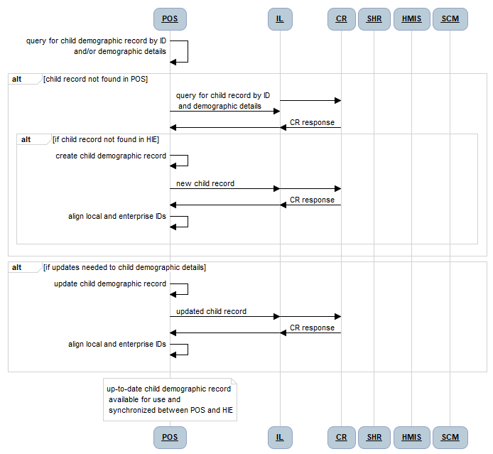
Solution Architecture

Slide 13
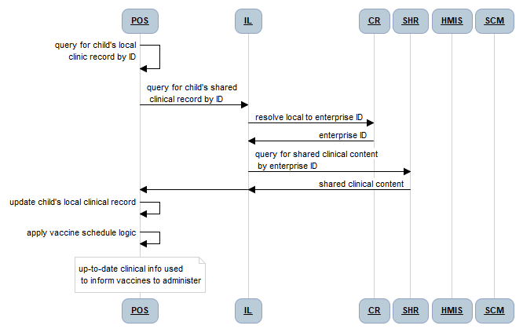
Solution Architecture

Slide 14
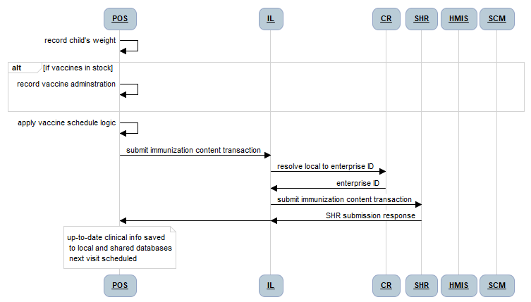
Solution Architecture

Slide 15
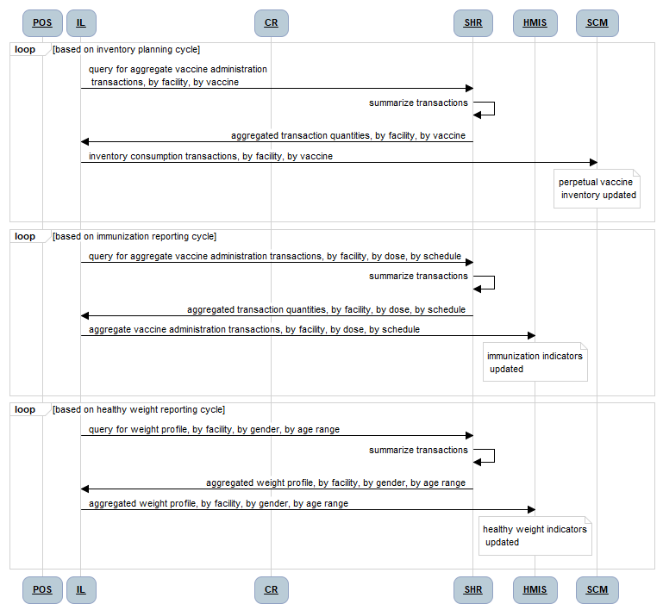
Solution Architecture

Slide 16
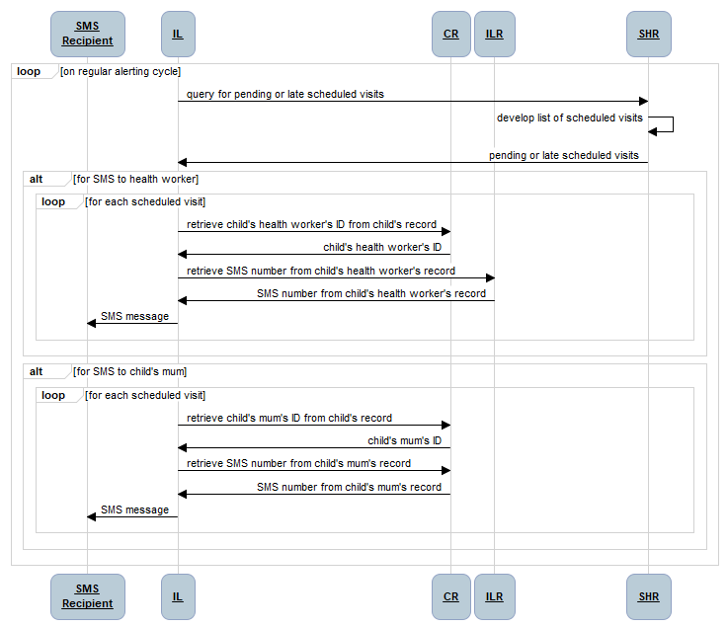
Solution Architecture

Slide 17
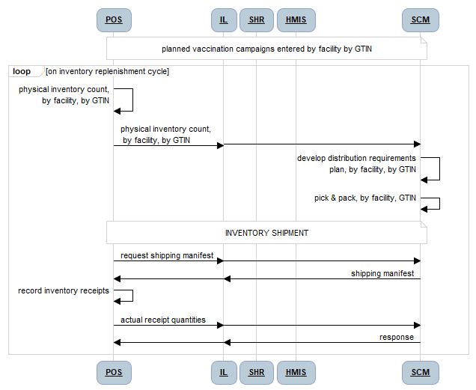
Solution Architecture

Slide 18
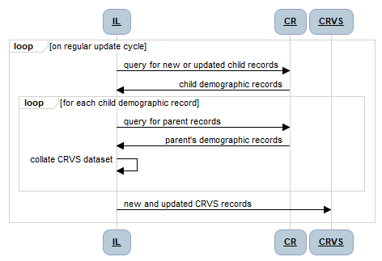
Solution Architecture

Slide 19
Solution Architecture
This is ONE example use case (childhood immunization)
There are many more examples
The patterns are highly re-usable across other use cases and across different software solution platforms (e.g. web, mobile, engineered paper)

Slide 20
Summary
The architecture needed for children isn’t different than the architecture needed for “everyone”
A relatively small set of functional “Lego blocks” is needed to serve a wide array of use cases
Point-of-service (POS) solutions will plug into the data sharing infrastructure so that care continuity and coordination can happen

