Slide 1
Supply Chain Information ENTITIES & Data Interfaces
Presented to the OHIE Supply Chain Subcommunity
November 16, 2017
Chris Wright

Slide 2
Discussion Points
Routine supply chain "points of presence"
The data that these points of presence share
What within these data need to be standardized
How these points of presence interact with each other & the larger HIE

Slide 3
Routine supply chain "points of presence"
Point-of-care (POC) dispensing and inventory/stock management (stand alone or within EMR or Hospital management system)
POC Asset-specific data: RTM from CCE equipment, test/stock from Lab equip. (e.g. GeneXpert)
POC SC reporting/replenishment
eLMIS (E2E visibility/traceability)
WMS/ERP
eProcurement (if outside ERP)
Transport fleet management system including GPS tracking
Asset management system (medical and cold chain equipment)
DHIS2 or other DWH
Master facility registry
Master product registry / Rx and medical equipment regulatory MIS
Adverse drug reactions (ADR) MIS
Supplier/procurement agent/donor systems (international)
Insurance/payer systems (connected with Rx payment schemes)

Slide 4
Indicative data these points of presence share
Product data
Item code/name
Source/manufacturer
Batch/lot number
Expiry date
Unit size
Value
Quality data
ADR
Vx Vial Monitor (VVM) status
Supply chain data
Consumption
Stock levels
Losses/wastage
Location
Equipment data
Make & model
Purchase date
Functionality
Temperature
Maintenance status

Slide 5
What needs to be standardized?
Product-specific data for traceability (e.g. GS1 standards)
IoT data for assets
Facility location (geocode) data
Sublocation (e.g. pharmacy store, OPC dispensary, IPC/ward dispensary, WH bin location)
Pharmaceutical Benefits Scheme codes
Other?

Slide 6
Interoperability in Practice: Ethiopia
Purchase orders for Ethiopia sync to Vitas
VITAS WMS
Supplier Data (UNFPA ERP)
mBrana (mobile)
Datamart
i-Import (medicine import approval)
Vitas cost, price data syncs to SAGE
Vaccine orders sent to VITAS from mBrana; order confirmation sent back
Purchase requests from VITAS sync to i-Import
i-Import & Vitas share Master Data
Data including stock status flows from VITAS and mBrana to a datamart and is presented in the SC Dashboard
Fanos Supply Chain Dashboard

Slide 7
Ethiopia Supplier Data
Problem: No visibility of supplier data including donations, e.g. UNFPA
Solution: Automatic data sync with UNFPA ERP so when a PO is generated at UNFPA for Ethiopia it is automatically captured in the Ethiopia LMIS (HCMIS)
Map item names
Notes:
Just a little more detail about two of the syncs, first the supplier sync
Obviously this is only one supplier, and a relatively small one (albeit 30% of all FP products in Ethiopia), but it illustrates some of the potential and also some of the challenges
Challenges are related to People – another supplier (nameless) said “well we need permission from the govt to share our data with…..the govt!!)
Technical – we had to map the products. Small number of items (<10), so doable, but not for hundreds of items. And will need updating if naming changes in either system

Slide 8
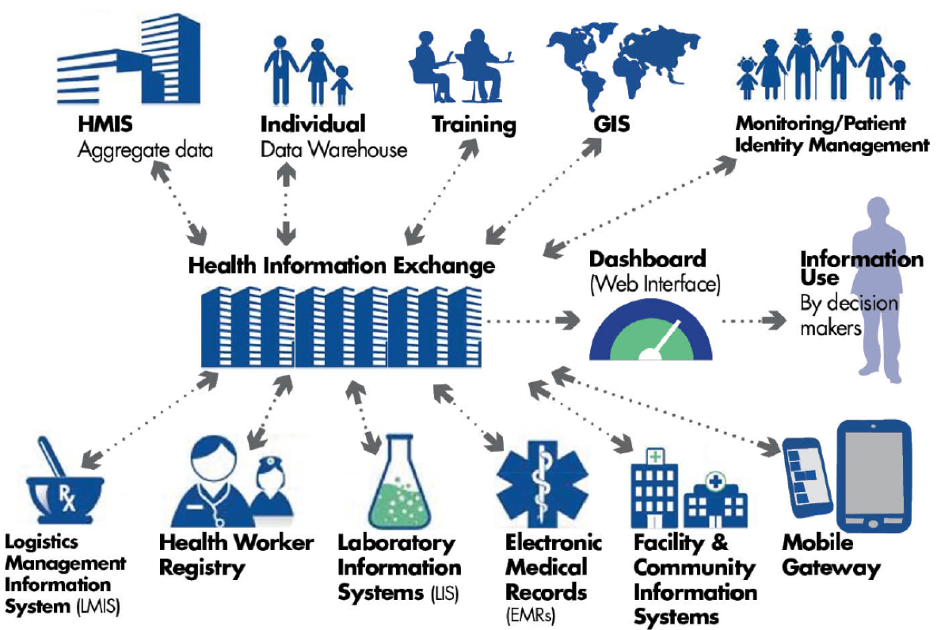
How these points of presence interact with each other & the larger HIE

Slide 9
Exchanging Data Between LMIS & HMIS
UN Commission on Lifesaving Commodities Enabling. 2016. Technology, People & Processes: Enabling Successful HMIS/LMIS Integrations.

Slide 10
Designing for Interoperability: Tanzania’s Vision
Notes:
And this is where Tanzania is heading.
As you can see, each domain is served by one of more fit-for-purpose technology solutions, each of which is optimized for that domain. But data is shared across domains, and eventual beyond the health sector to include civil registries that include birth and death registration and provide the unique identifier for every client seeking health services and products.
So my message to you is that today’s technology tools are useful and important, but they are mere interim steps to a much more atomized and interconnected future.
For decades. JSI has been a leading advocate for strengthening routine health information systems, and we are enthusiastic supporters of DHIS2 and other platforms in the countries where we work. But we and our partners at CHAI and VillageReach also believe that no single information platform can serve the diverse needs across so many domains, any more than a hammer can be the only tool to build a house.
We need to constantly be looking for and supporting the use of the best-in-class information technologies for each domain, and have the vision of knowing that today’s solutions are not stand-alone, but are part of an expanding ecosystem of health information system applications.

Slide 11
Thank you

