Slide 1
Use Case Example – Version 1

Slide 2
Use Case Example 2

Slide 3
Use Case Example 3

Slide 4
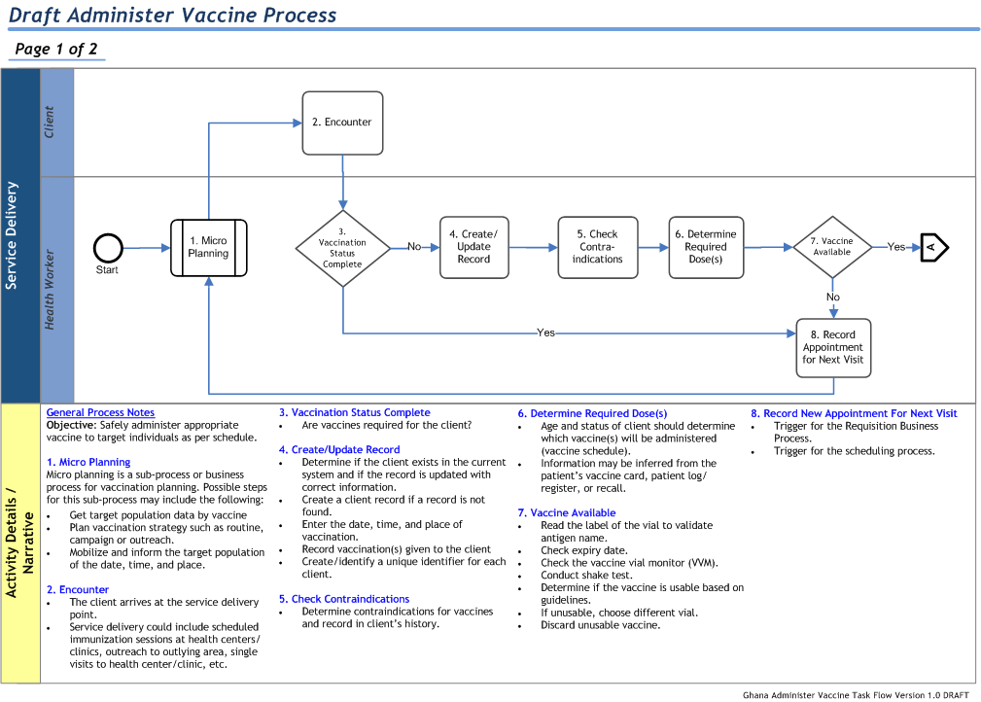

Slide 5
Use Case Example # 4
FRED – Facility Registry Expansion Development
Use Case Framework & Collection Worksheet:
Use case # & name | Persona or Role… | …wants to… | …in order to.. | Use Case type (Core/Client) | Submitted by
1 – Create record | MoH responsible | Create facility record | Populate facility database | Core | Fredrik Winsnes
2 – Maintain record | MoH responsible | update facility record | Keep database current | Core | Fredrik Winsnes
3 – facility code lookup | NGO M&E specialist | Look up a facility code based on location | Report accurate M&E activity data | Client | Fredrik Winsnes
4 – etc.

